Slide 1
Building Microsoft Edge Extensions
Joris Brauns & Steven Liekens

Slide 2
Extension platform
Use HTML/JS/CSS to develop extensions
JSON extension manifest file
Compatible with Chrome extensions
Migrate with minimal changes
Microsoft Edge Extension Toolkit
Bridge to Chrome APIs

Slide 3
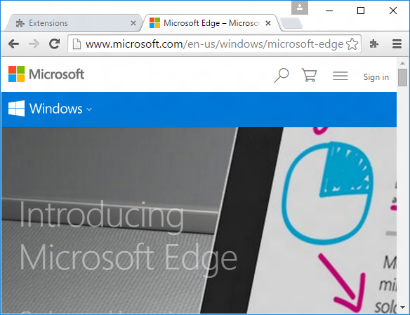
Modern Extension architecture
Package
manifest.json
background.js
messages
popup.js
content.js

Slide 4
API Classes
UI
browserAction
pageAction
contextMenus
Browser
tabs
windows
Inter-context msgs
runtime
International
i18n
tabs.detectLanguage
User
cookies
storage
Extension settings
extension
Network
webNavigation
webRequest
OS interop
idle

Slide 5
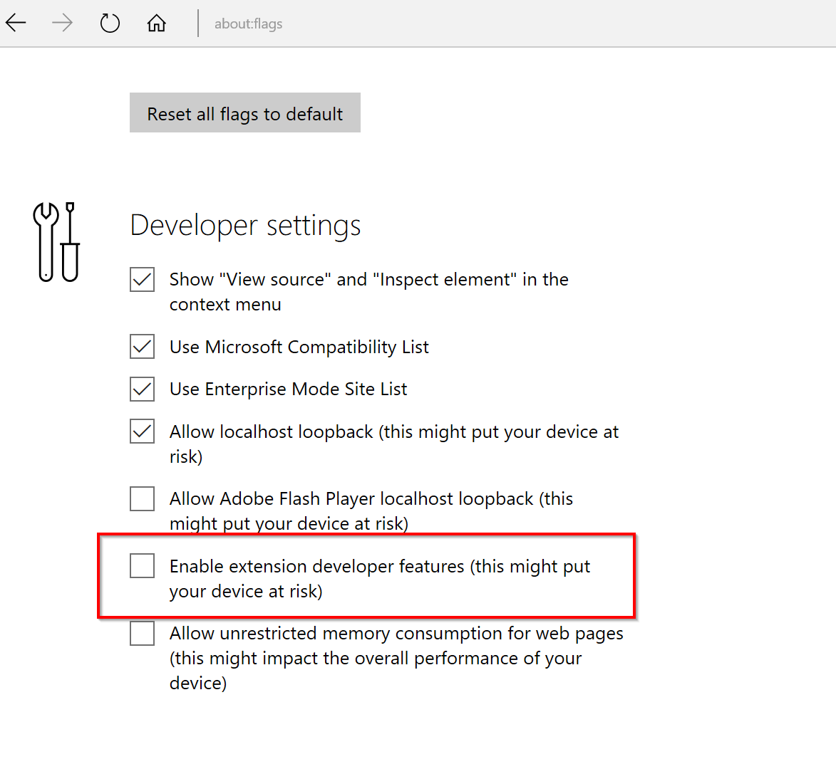
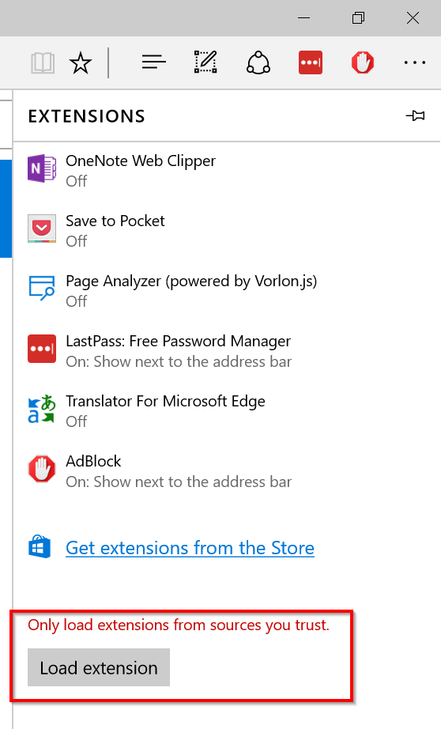
Developing extensions
Your editor of choice
Enable side-loading through about:flags
Debugging using F12 tools

Slide 6
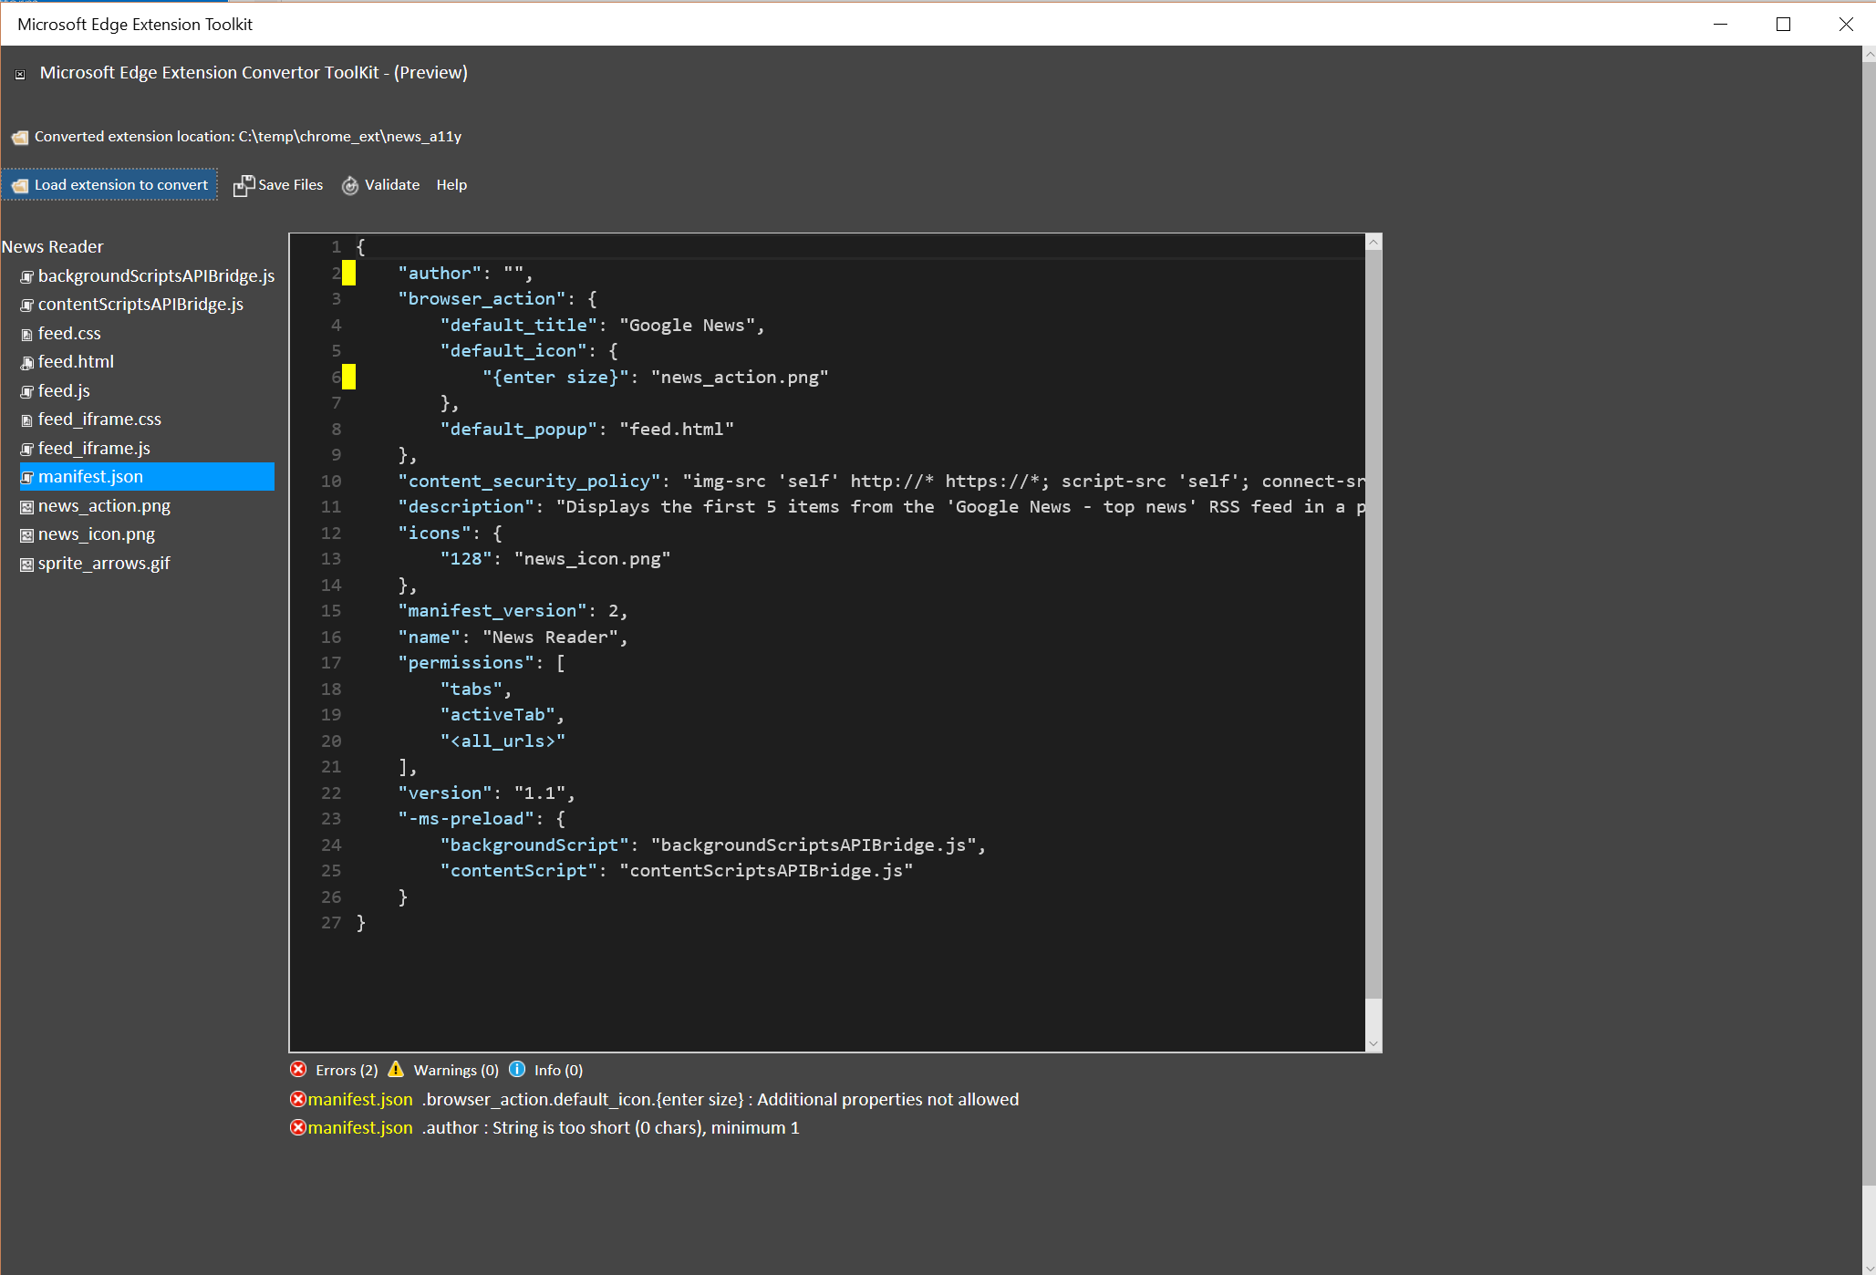
Edge Extension Toolkit

Slide 7
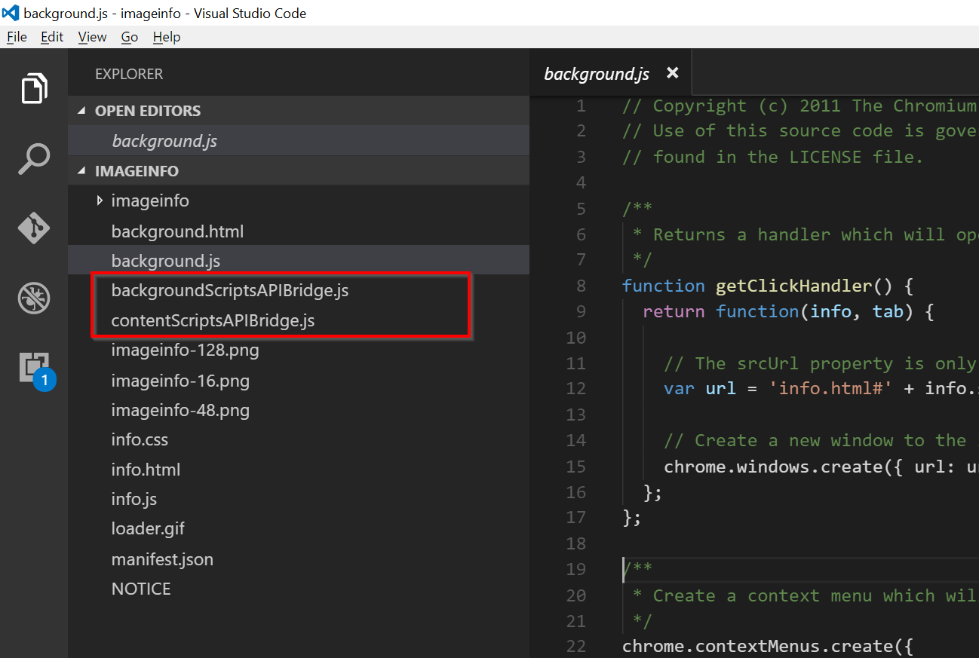
Chrome API Bridges

Slide 8
Demo
Developing a HTML/JS Extension

